Slide 1


Dr. Mahalingam College of Engineering and Technology
Pollachi, Tamilnadu, India
Department of Information Technology
16ITL81-Project (2018-2022 Batch)
Batch No: 18
Viva Voce
INTELLIGENT HEALTHCARE ANALYTICS
Guided by
Dr. S. Ponni @ Sathya (ASP/IT)
Submitted by
Gokul K S(727622BIT068)
Premkumar T(727622BIT070)
Vasantha Kumar V(727622BIT072)
1
Notes:
1

Slide 2
OUTLINE
Project Title
Abstract
Objective
Literature review
Existing system
Drawbacks in Existing System
Proposed system and its advantages
Tool(s) used for implementation
Proposed Modules identification and description
Implementation work
Result
Conclusion
Future Work
References
2

Slide 3
Project Title
INTELLIGENT HEALTHCARE ANALYTICS

Slide 4
Intelligent Healthcare Analytics
Intelligent Healthcare Analytics refers to a smart, data-driven system designed to modernize healthcare services by analyzing patient feedback, monitoring hospital resources, and providing real-time insights. The system leverages interactive dashboards, AI-powered chatbots, and automation tools to enhance decision-making, improve patient satisfaction, and optimize hospital operations—all in a seamless, intelligent platform.
4
Notes:
4

Slide 5
Abstract
The healthcare industry is rapidly evolving with new technologies aimed at improving patient care. Intelligent Healthcare Analytics is a system developed to analyse patient feedback, treatment outcomes, and hospital resource utilization using Power BI dashboards and AI-powered tools. The project uses a Kaggle-sourced dataset that includes patient reviews related to their treatments, diseases, and recovery timelines. It transforms this data into interactive dashboards that offer valuable insights into treatment effectiveness, patient satisfaction, and overall hospital performance. An AI-integrated chatbot, developed using Chatbase.co, enhances user interaction by providing real-time, query-based responses from the analyzed dataset. Additionally, a Bed Vacancy Monitoring Module tracks real-time bed availability and occupancy by connecting to the hospital database. Together, these modules create a unified system that supports data-driven decisions and delivers smarter, more responsive healthcare services.
5
Notes:
5

Slide 6
Objective
The primary objective of the Intelligent Healthcare Analytics system is to enhance the quality of healthcare services by leveraging modern data analytics and intelligent automation. The system aims to:
Collect and process patient feedback through a secure, web-based interface to capture insights on treatment quality, staff behaviour, and hospital infrastructure.
Perform real-time data analysis using Power BI to visualize key healthcare metrics such as patient satisfaction, disease trends, and recovery durations.
Provide intelligent, conversational support through an AI-powered chatbot (integrated via Chatbase.co), enabling users to access data-driven insights through natural language interaction.
Implement a dynamic bed vacancy monitoring module to display real-time information on hospital bed availability, improving resource allocation and emergency responsiveness. and patient care.

Slide 7
Existing System
Current healthcare feedback systems rely heavily on manual processes such as paper forms, interviews, and basic online surveys. These methods are time-consuming, lack real-time processing, and often result in delayed analysis of patient feedback. Existing systems typically do not include intelligent features like automated data visualization or AI-powered support, making it difficult for providers to respond promptly to patient concerns. Additionally, patient interaction tools such as chatbots are rarely integrated, and bed availability tracking is managed manually or through limited-access systems. Overall, these traditional approaches are fragmented, inefficient, and fail to deliver a seamless, real-time, and patient-centric experience.
7
Notes:
7

Slide 8
Drawbacks of Existing System
Lack of Automation: Feedback is collected but not analyzed in real-time. Manual efforts are required to sort, categorize, and interpret responses, leading to delays in decision-making.
Limited Data Utilization: Many healthcare providers fail to leverage the full potential of the collected feedback, resulting in valuable insights being overlooked.
Poor Visualization: Most existing systems do not provide dynamic visual representations of feedback data. As a result, healthcare administrators find it challenging to quickly identify trends, issues, and areas for improvement.
Absence of Immediate Patient Assistance: Current systems do not offer real-time support to patients for symptom checking or answering queries. Patients must wait for human support, which can delay care and reduce satisfaction.
Fragmented Systems: Often, feedback collection, patient assistance, and data analysis are handled by separate platforms, leading to inefficiencies and poor integration.
8
Notes:
8

Slide 9
Literature Review
Traditional healthcare feedback systems, such as paper surveys and phone interviews, are time-consuming, inefficient, and prone to errors, leading to low response rates and delayed analysis. Studies show that these methods fail to provide real-time insights or actionable data for decision-making, limiting healthcare providers’ ability to respond quickly to patient needs (Smith et al., 2018).
Digital platforms have emerged to collect patient feedback, but many lack advanced analytics like machine learning and sentiment analysis, which could help extract meaningful insights (Williams et al., 2019). Real-time data, such as bed vacancy checks and symptom tracking, is critical for improving healthcare delivery, but is often missing in current systems (Nguyen & Zhang, 2022).
AI-powered tools like chatbots are increasingly used to engage patients and automate feedback responses, improving satisfaction and reducing staff workload (Bates et al., 2021). However, challenges such as data privacy, integration with existing systems, and high implementation costs remain barriers to widespread adoption (Brown & Tan, 2022).

Slide 10
Proposed System
By combining data analytics, artificial intelligence, and real-time monitoring, the suggested system, Intelligent Healthcare Analytics, aims to modernize how hospitals handle patient feedback and allocate resources. A structured hospital dataset comprising patient feedback, treatment specifics, and recovery dates over a predetermined period forms the basis of the system. Microsoft Power BI is used to analyze this data, allowing for the development of an interactive dashboard that shows important metrics like recovery times, disease trends, treatment efficacy, and patient satisfaction levels. The system includes a Chatbase.co-powered chatbot to improve accessibility and user interaction. The chatbot gives users precise, data-driven answers based on the insights that have been analyzed. Additionally, the system has a Bed Vacancy Monitoring Module that tracks occupied and available beds in real time, enhancing operational effectiveness and supporting emergency response. By integrating these elements, the suggested system provides a scalable, intelligent way to enhance healthcare services, empowering medical professionals and hospital administrators to make timely, significant, and well-informed decisions.

Slide 11
Advantages of Proposed System
Efficient Feedback Collection
Streamlines the feedback process with a digital interface, leading to higher response rates and quicker data collection.
Real-Time Data Insights
Provides healthcare administrators with real-time analytics via Power BI dashboards, enabling timely, informed decision-making.
Improved Patient Engagement
AI-powered chatbot enhances patient interaction, offering immediate responses and improving satisfaction.
Resource Optimization
The real-time bed vacancy checker optimizes hospital resource allocation, improving patient access to available services.

Slide 12
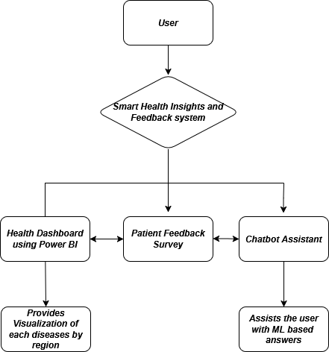
Flow Diagram
Intelligent HealthCare Analysis

Slide 13







Tools used for Implementation
HTML, CSS, JavaScript, Bootstrap
Python
Django
SQLite3
Power BI
VS Code

Slide 14
Proposed Modules
Feedback Collection Module:
Gathers patient feedback via survey forms and a chatbot, capturing both structured and unstructured data. All feedback is securely stored with timestamps.
Power BI Visualization Module:
Presents insights through interactive dashboards with charts and heatmaps, enabling real-time tracking of patient satisfaction and service quality.
AI-Powered Chatbot Module:
Answers FAQs, manages appointments, and includes a symptom checker. Also collects feedback conversationally, improving patient engagement and reducing staff workload.
Bed Vacancy Checker Module:
Provides real-time updates on hospital bed availability across departments. Helps staff and patients make quick decisions regarding admissions and transfers.

Slide 15
Implementation work
The Intelligent Healthcare Analytics system integrates multiple modules to enhance patient engagement and streamline hospital operations. It begins with a digital feedback form built using HTML, CSS, JavaScript, and Django, allowing patients to share treatment experiences. Feedback is stored securely in an SQLite database and analyzed using Power BI, where interactive dashboards visualize patient satisfaction and trends in real time. An AI-powered chatbot, integrated via Chatbase.co, responds to user queries and offers basic symptom guidance. Additionally, a real-time bed vacancy checker fetches data from the hospital database to display current bed availability across departments. Together, these modules deliver a data-driven, patient-centric healthcare solution with improved efficiency and support.

Slide 16
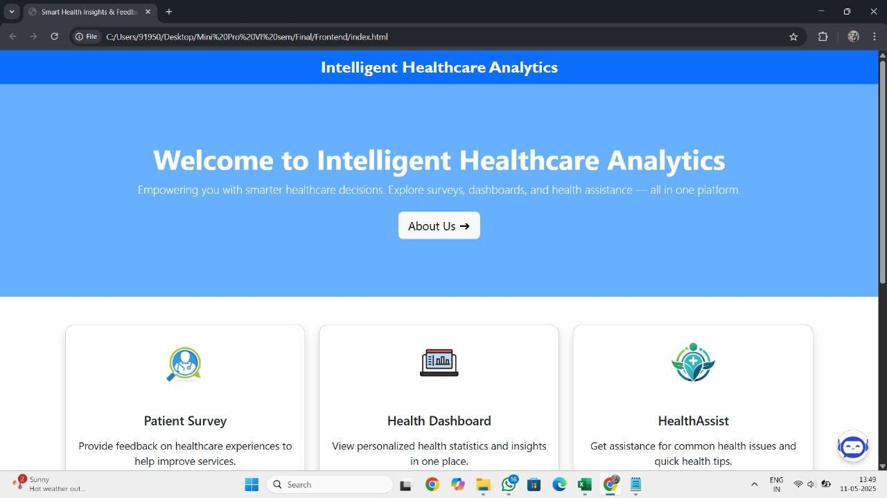
Result
Home Page

Slide 17
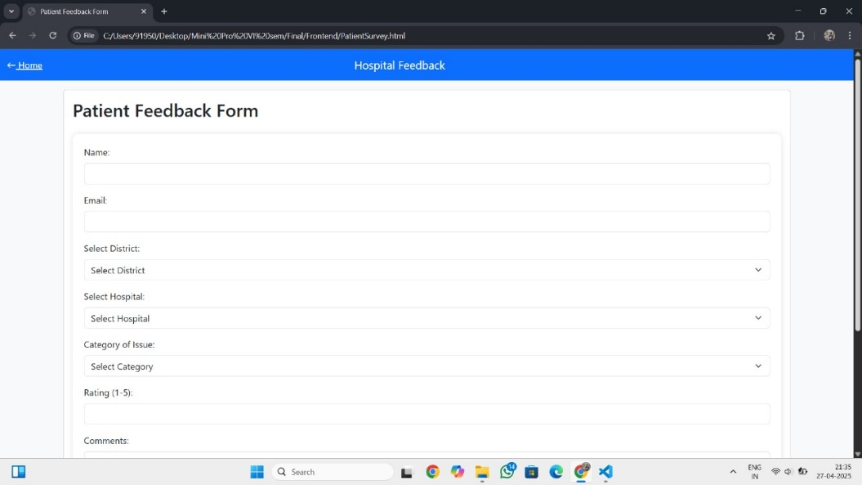
Result
Patient Survey Page

Slide 18
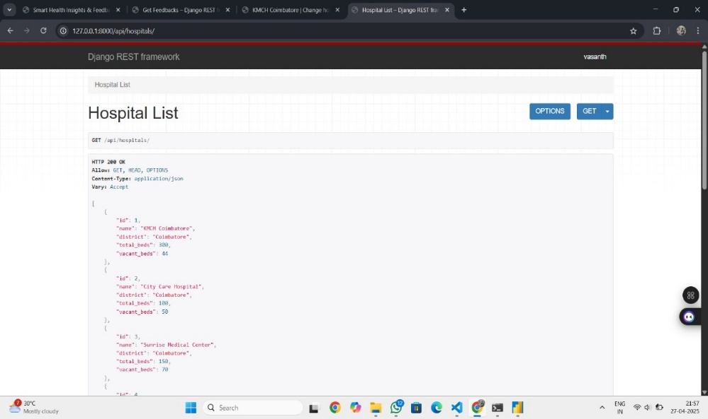
Result
Database

Slide 19
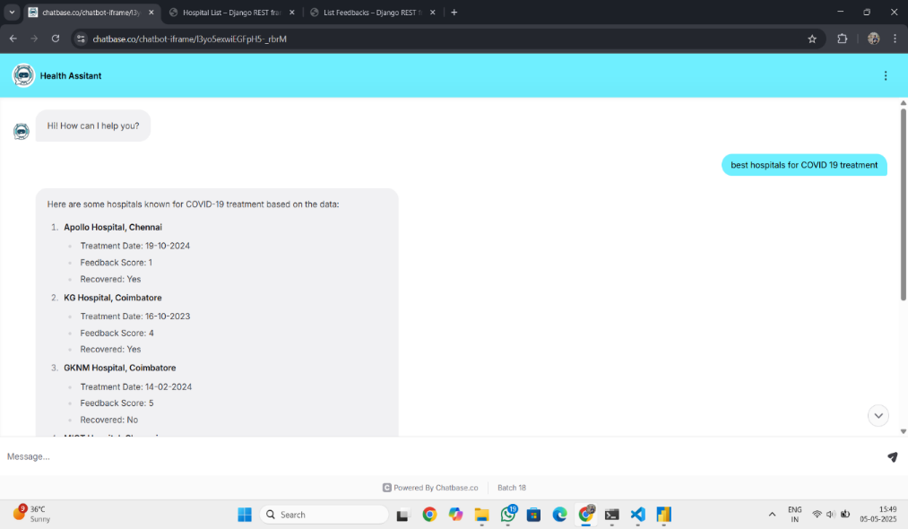
Result
Health Assistant

Slide 20
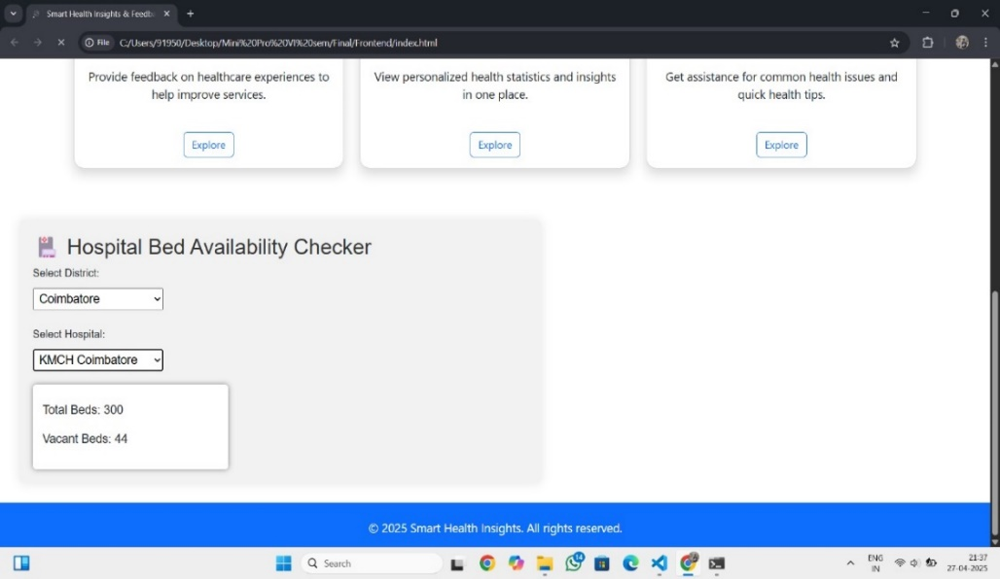
Result
Bed Vacancy Checker

Slide 21
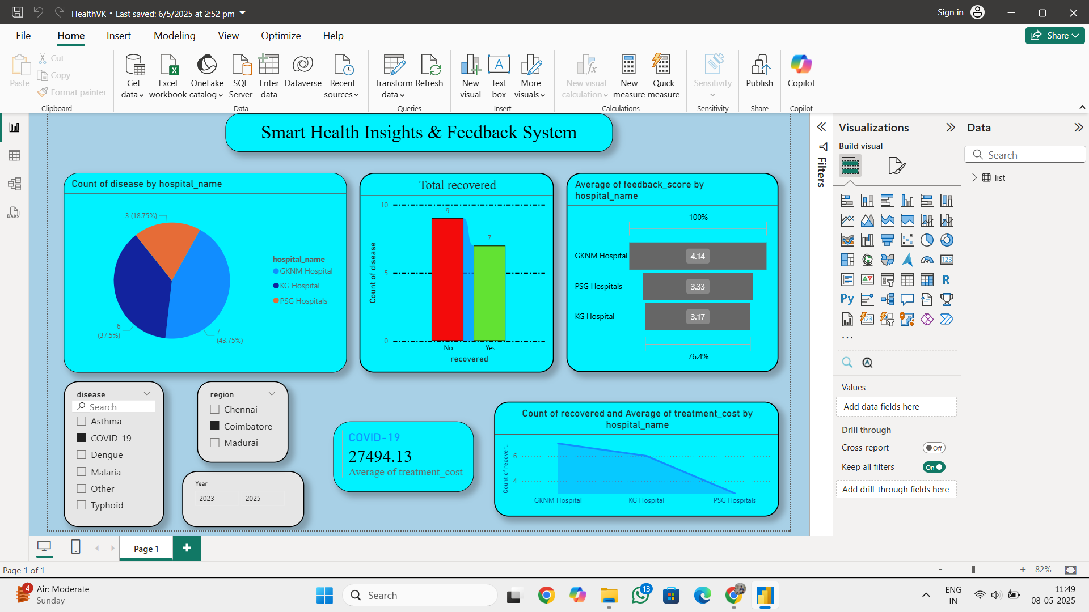
Result
Power BI Dashboard

Slide 22
Conclusion
The Intelligent Healthcare Analytics integrates advanced technologies like machine learning, AI, real-time data analysis, and cloud computing to enhance healthcare delivery and patient engagement. It provides a unified platform for collecting patient feedback, offering AI-powered support, and delivering real-time insights. The system improves patient satisfaction and service quality by enabling continuous health monitoring, automated feedback analysis, and 24/7 support. Its scalability and cloud-based architecture ensure accessibility, security, and performance, benefiting both healthcare providers and patients by improving efficiency and personalized care.

Slide 23
Future Work
Enhanced AI and Machine Learning: Improve the accuracy of health predictions, disease detection, and personalized recommendations using advanced AI models and deep learning techniques.
Integration with Wearables: Expand the system’s capability to integrate with a wide range of wearable devices for continuous health monitoring, providing real-time data to both patients and healthcare providers.
Improved Data Security: Focus on strengthening data security with end-to-end encryption, ensuring compliance with healthcare regulations to safeguard sensitive patient information.

Slide 24
References
Chen, M., Hao, Y., Cai, Y., Wang, Y., & Li, Y. (2021). Sentiment analysis of online healthcare reviews using deep learning approaches. IEEE Access, 9, 17242–17251. https://doi.org/10.1109/ACCESS.2021.3053032
Alharbi, A., Qureshi, M. R. J., & Alharbi, A. A. (2020). Role of data visualization in healthcare decision-making using Power BI. Journal of Healthcare Engineering, 2020, 1–9. https://doi.org/10.1155/2020/8894691
Zhang, Y., Chen, H., & Lee, P. (2022). Integrated digital platforms for improving hospital operations and patient engagement. Journal of Healthcare Engineering, 2022, 1–12. https://doi.org/10.1155/2022/4658307

Slide 25
QUERIES?☺
25

Slide 26

THANK YOU☺
26

